Slide 1
Software Project Management

Slide 2
Objectives
To understand the need, scope and purpose of project planning.
To describe the project planning process.
To develop a project plan.
To perform project scheduling using techniques such as Gantt chart, PERT chart and critical path method.
To understand the need for tracking a project schedule.
To explain project staffing and project monitoring.
To develop the risk management plan.

Slide 3
Why SPM??
Concerned with activities involved in ensuring
that software is delivered on time and on
schedule and in accordance with the
requirements of the organization developing
the software.
Project management is needed because software development is always subject to budget and schedule constraints that are set by the organization developing the software.

Slide 4
Topics covered
Project planning
Project scheduling

Slide 5
Project planning
Before starting a software project, it is essential to determine the task to be performed and properly manage allocation of tasks among individuals involved in software development.

Slide 6
Objectives of project planning
It defines the roles and responsibilities of the project management team members.
It ensures that the project management team works according to the objectives.
It checks the feasibility of the user requirements.
It determines project constraints.

Slide 7
Principles of project planning
Clear project planning
Risk analysis
Tracking of project plan
Meet quality standards
Description of flexibility

Slide 8
Project Scheduling
Scheduling is an important project planning activity.
Steps :
Identify all the tasks needed to complete the project
Break down large tasks into small activities.
Determine the dependency among different activities.
Allocates resources to activities.
Plan the starting and ending dates for different activities.
Determine the critical path.

Slide 9
Work Breakdown Structure (WBS)
It is used to decomposed a given task into small activities.

Slide 10
Activity Networks
WBS representation of a project is transformed into an activity network by representing activities identified in WBS along with their inter-dependencies.
An activity network shows the different activities making up a project, their estimated durations and inter-dependencies.

Slide 11
Activity Networks
Each activity is represented by a rectangular node and the duration of the activity is shown along with the task.
Design database
45
Code database
105
Integrate and test
120
Specification
15
Finish
0
Design GUI
30
Code GUI
45
Write user manual
60

Slide 12
Critical Path Method (CPM)
Project parameters:
MT(minimum time) to complete the project
= maximum of all paths from start to finish
ES(earliest start) time of a task = maximum of all paths from start to this task
LS(latest start) time = MT- maximum of all paths from this task to finish

Slide 13
Critical Path Method (CPM)
Project parameters:
EF(earliest finish) time of a task = ES time + duration of the task
LF(latest finish) time of a task = LS time + duration of the task
ST(slack time) = LS-ES (or LF-EF).
Slack time is the total time that a task may be delayed without affecting the end time of the project.

Slide 14
Critical Path Method (CPM)
Compute the project parameters for the following activity network.
Design database
45
Code database
105
Integrate and test
120
Specification
15
Finish
0
Design GUI
30
Code GUI
45
Write user manual
60

Slide 15
Task | MT | ES | LS | EF | LF | ST
Specification | 285 | 0 | 0 | 15 | 15 | 0
Design database |  | 15 | 15 | 60 | 60 | 0
Design GUI |  | 15 | 90 | 45 | 120 | 75
Code database |  | 60 | 60 | 165 | 165 | 0
Code GUI |  | 45 | 120 | 90 | 165 | 75
Integrate and test |  | 165 | 165 | 285 | 285 | 0
Write user manual |  | 15 | 225 | 75 | 285 | 210

Slide 16
Critical Path Method (CPM)
Task | MT | ES | LS | EF | LF | ST
Specification | 285 | 0 | 0 | 15 | 15 | 0
Design database |  | 15 | 15 | 60 | 60 | 0
Design GUI |  | 15 | 90 | 45 | 120 | 75
Code database |  | 60 | 60 | 165 | 165 | 0
Code GUI |  | 45 | 120 | 90 | 165 | 75
Integrate and test |  | 165 | 165 | 285 | 285 | 0
Write user manual |  | 15 | 225 | 75 | 285 | 210

Slide 17
Gantt Chart
Gantt charts are mainly used to allocate resources to activities include staff, hardware and software.
Gantt chart is a special type of bar chart where each bar represents an activity.
The bars are drawn along a time line.
The length of each bar is proportional to the duration of time planned for the corresponding activity.

Slide 18
Gantt Chart
Each bar consists of a shaded part and a white part. The shaded part shows the length of the estimated time and white part shows the slack time.

Slide 19
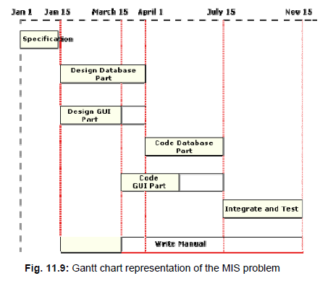
Gantt Chart

Slide 20
Notation | Activity | Duration (months)
T1 | Requirement specification | 1
T2 | Design Database part | 2
T3 | Design Interface part | 2
T4 | Code database part | 5
T5 | Code interface part | 3
T6 | Code control processing part | 2
T7 | Integrate and test | 6
T8 | Write user manual | 3
The following precedence relation holds among the different tasks:
T1<{T2,T3}<{T4,T5,T6}<T7
Draw the Activity network and Gantt Chart. Also find the Critical path.

Slide 21
PERT Chart
Project Evaluation and Review Technique chart.
It consists of a network of boxes and arrows.
Boxes represents the tasks with the variations in the project estimation.
pessimistic, nominal and optimistic estimation.
There may be more than one critical path, depending on the permutations of the estimates for each task.

Slide 22
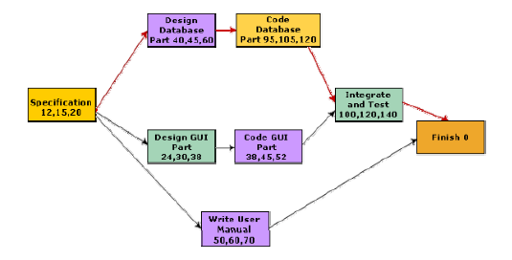
PERT Chart

Slide 23
Project Monitoring
Project manager has to monitor the project continuously to ensure that it is progressing as per plan.
Milestones are designated.
The tasks along a critical path are called critical task.
If necessary, a manager may switch resources from a non-critical task to a critical task.

Slide 24
Project Staffing
The number of team members required in a project depends on the type of project and the effort and cost required for it.
Project staffing is the process of searching, evaluating and establishing a working relationship among the members of a project.
It is important to assign different roles and responsibilities to different individuals according to their skill, abilities and experience.

Slide 25
Project Staffing
Factors for staffing:
Application domain experience
Platform experience
Programming language experience
Educational qualification
Communication ability
Team spirit

Slide 26
Project Staffing
Principles of project staffing:
The task should be assigned to staff members according to their skills and abilities.
Every staff member should be assigned a designation.
Every staff member should be constrained to follow the guidelines and standards of the organization.

Slide 27
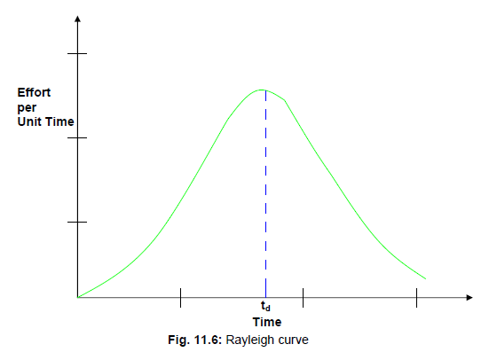
Effort vs. Time

Slide 28
Putnam’s Work
By analyzing a large number of projects, Putnam derived the following expression:
L=P (E)^{1/3} (t_{d})^{4/3}
Where, L is the project size in KLOC
P is software quality parameter
E= total effort in person-months
t_{d}= the project duration in months

Slide 29
Putnam’s Work
The effort can be calculated by the following equation:
E= L³/(P³t_{d}⁴)

Slide 30
Effect of schedule change on Cost
From Putnam’s proposed expression
E= (L³/P³)*1/t_{d}⁴

